Slide 1
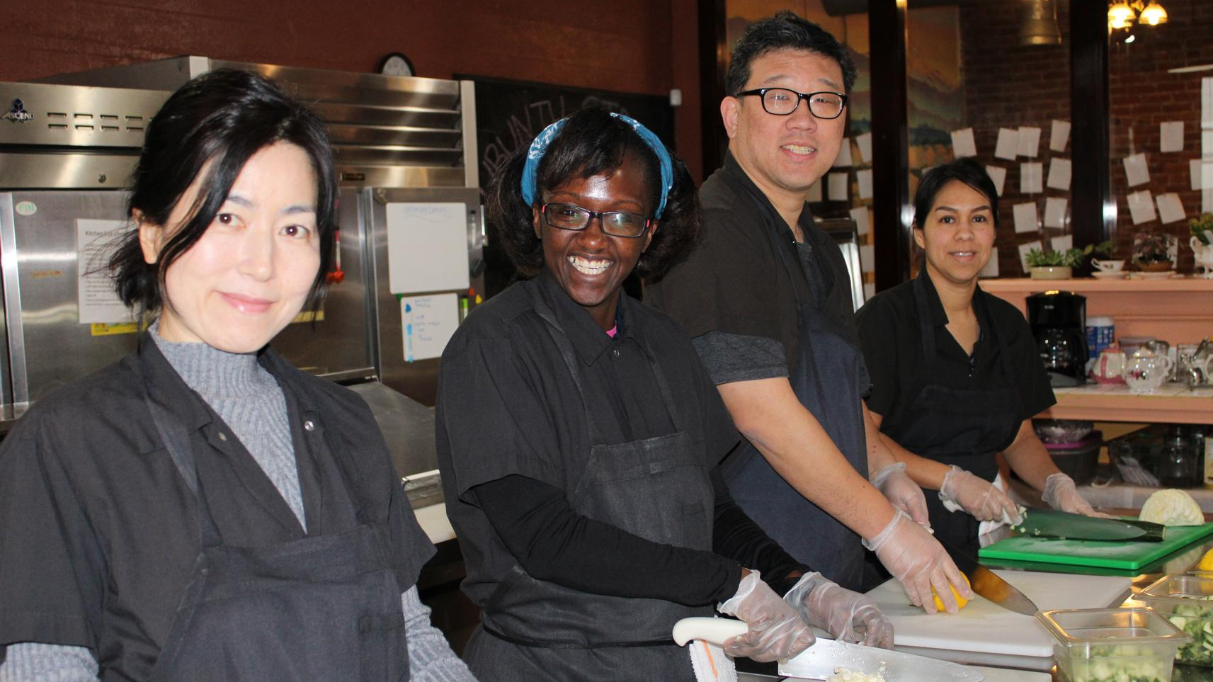


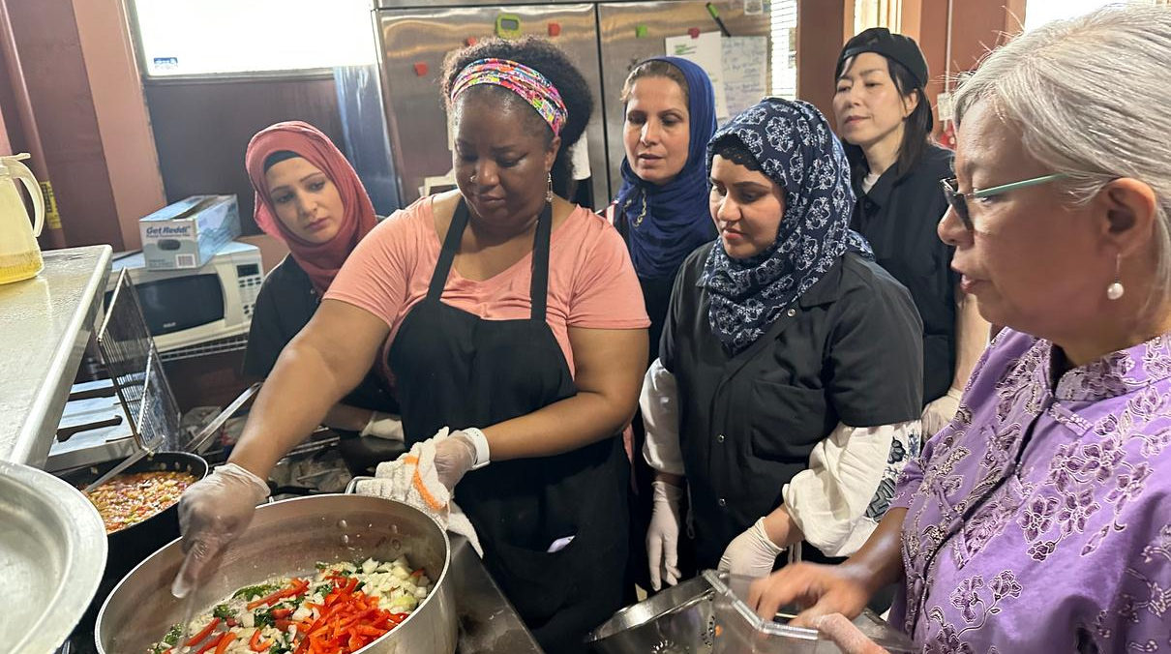

Project Feast
VISION
At Project Feast, we cultivate a nurturing space for refugees and immigrants, while providing culinary training that equips them for careers or entrepreneurship in the food industry. We empower our students to share their diverse stories and cuisine, fostering intercultural exchange that enriches and unites our community.
MISSION
We aspire to create a future where immigrants and refugees possess the skills necessary for a fulfilling and prosperous career in the dynamic world of culinary arts. We embrace diversity as a powerful tool, empowering individuals to unlock their hidden potential, gain confidence, and cultivate success.
VALUES
  Community-centric approach
  Integrity and accountability
  Empowerment & confidence building
  Value & appreciation of cultural heritage

Slide 2
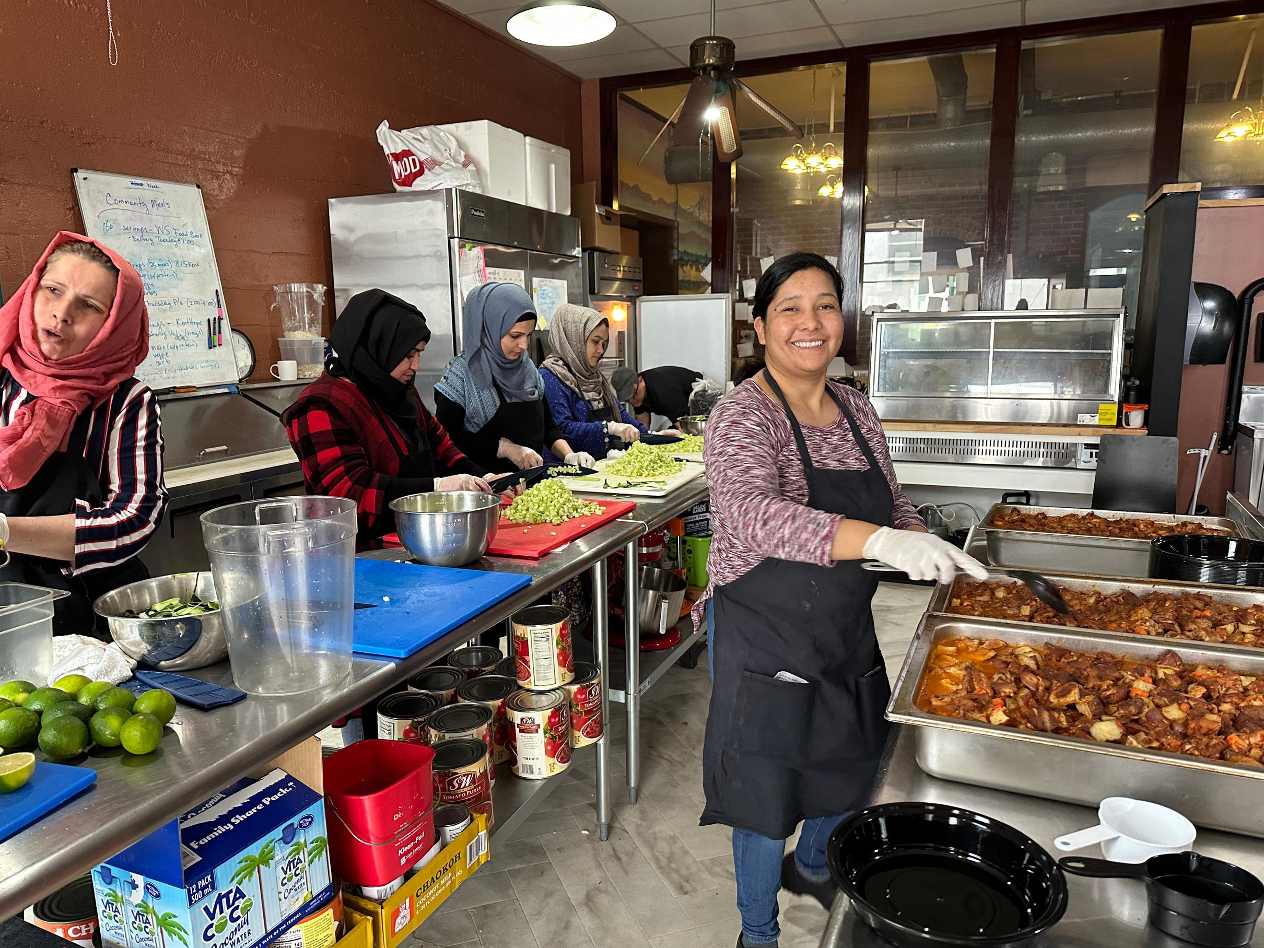
Our Impact
Project Feast’s Culinary Apprenticeship Program is a platform for our participants to share their stories and cuisine. Apprentices receive hands-on training in our commercial kitchen where they work alongside staff preparing meals for our café, catering, and food assistance program.
Additionally, in the past year we:
  Re-opened our training cafe for lunch service (after a 4 year closure starting from the pandemic lockdown).
  Offered 13 different Family Meals – our take-out program featuring menus inspired by staff, alumni, and apprentices.
  Prepared over 150 meals a week for our hunger relief program which provides nutritious, ethnic meals to food insecure families and seniors in our community. We have distributed over 50,000 meals since 2020!
  Graduated 18 apprentices including 15 recently settled Afghan refugee women. We are on track to graduate another 18 women this year!
  Supported two alumni in their efforts to start a catering company by providing them with start-up funds as well as a steeply discounted price to rent our kitchen space.
  Been awarded over $300,000 dollars in grant funding to support our growth.

Slide 3
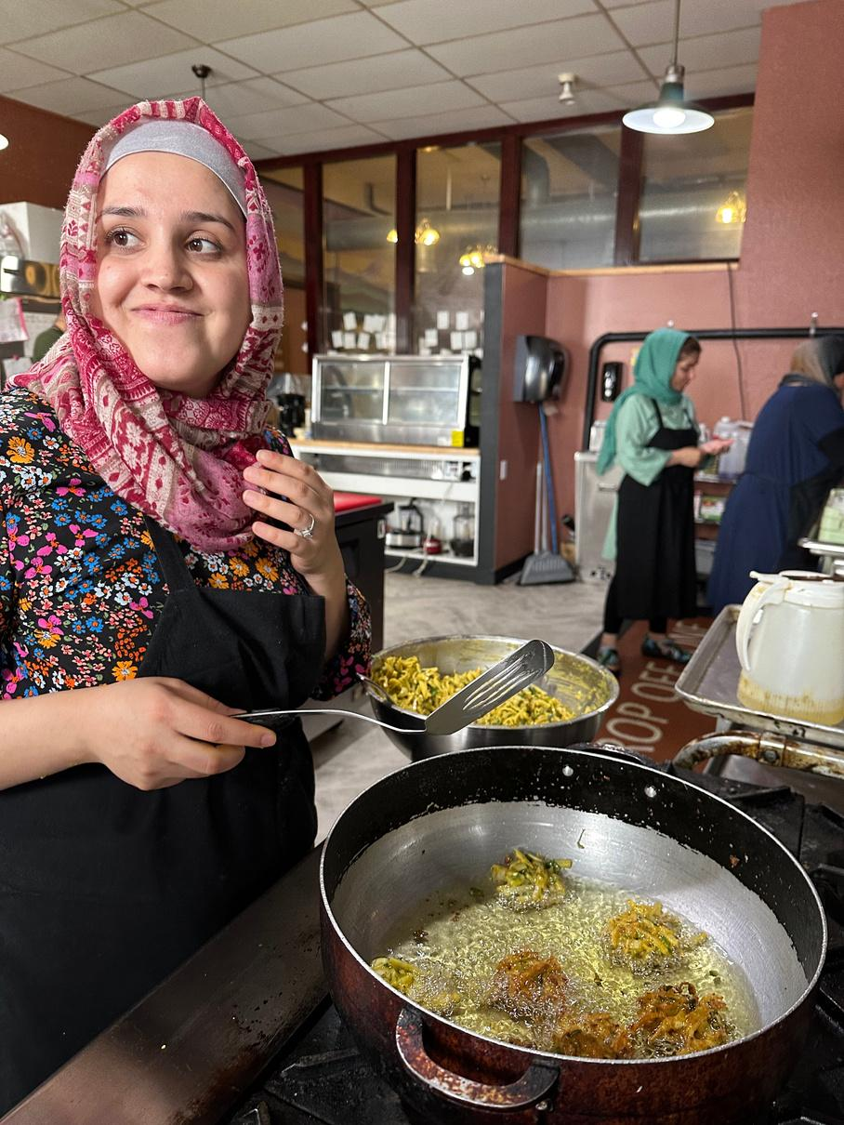
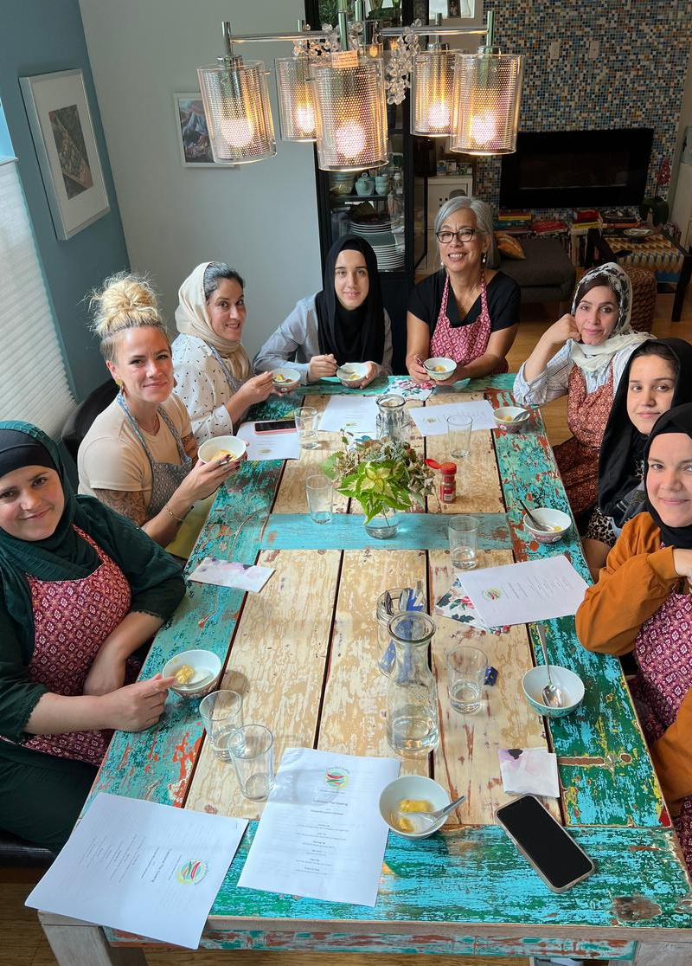
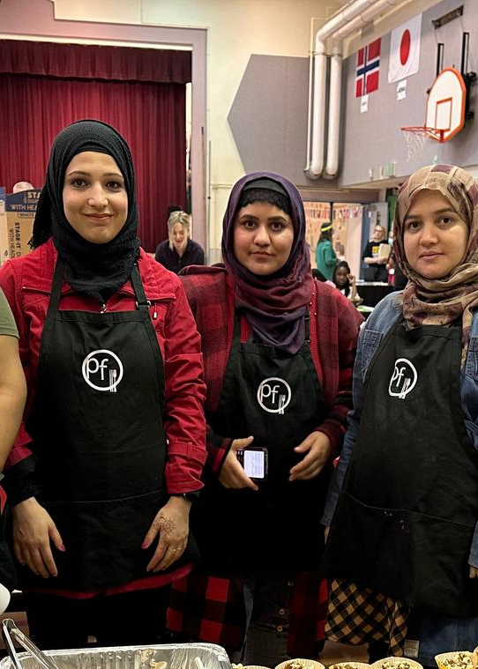
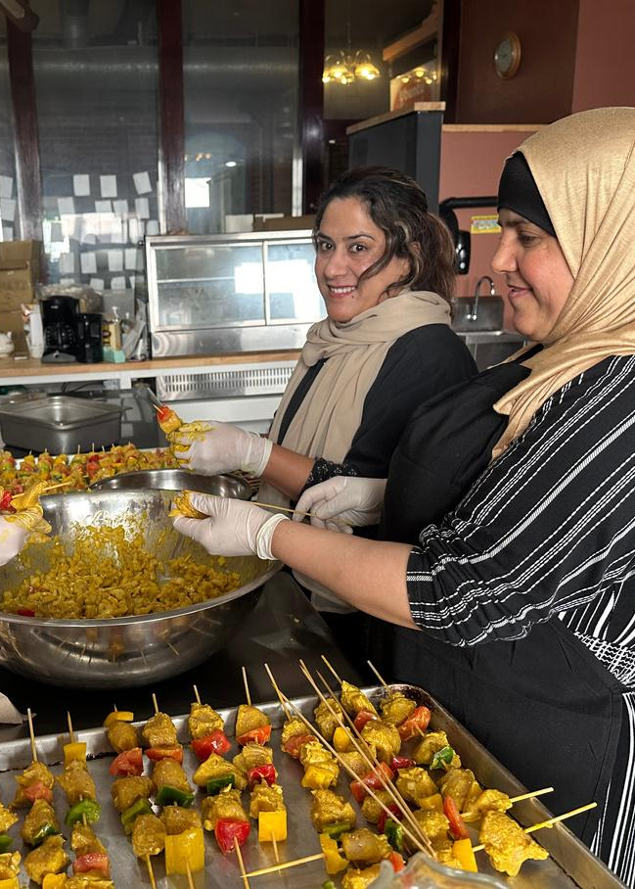
Feast For A Change Sponsorships
Platinum
$2,500+
Gold
$1,500-$2,499
Silver
$1,000-$1,499
Sponsor us and join our mission to empower immigrants and refugees, and to continue sharing their stories with the community!
For more details on sponsorship tiers, please see our Sponsorship Agreement Form.
You can also reach out to Radhika Makhija, our fundraiser chair (radhi0325@gmail.com), for more information.

Slide 4
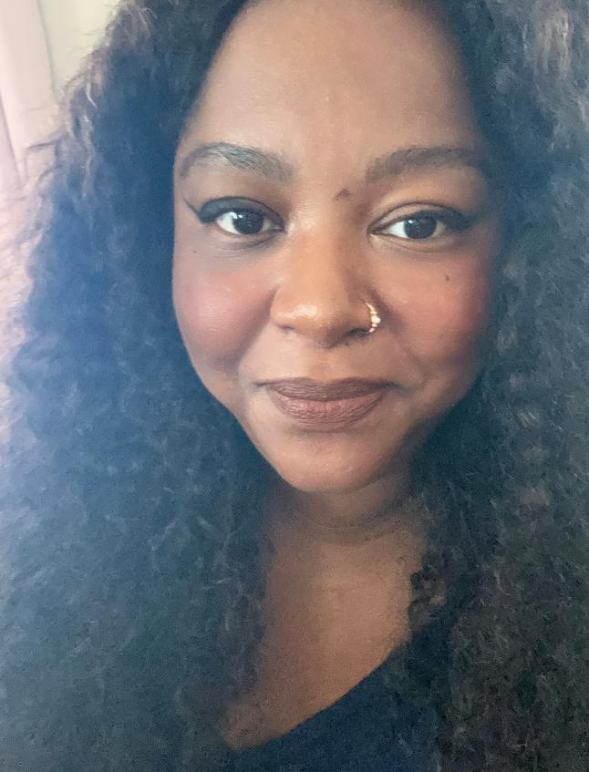
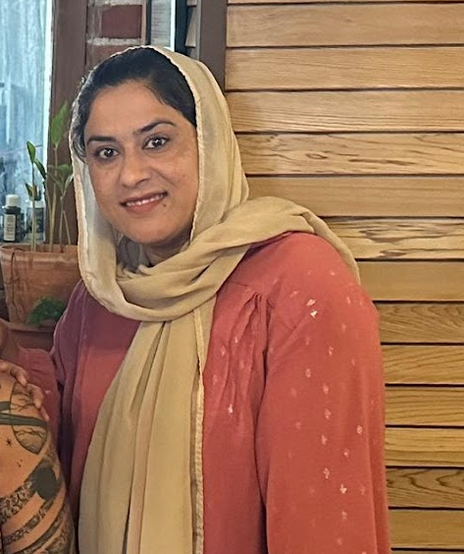
GRADUATE
TESTIMONIALS
“Being an apprentice at Project Feast was one of the best experiences of my life. The program transformed me from a modest home cook into a culinary adventurer, equipped with a repertoire of skills that have helped me navigate the intricacies of the food industry, and overcome the many challenges of running a food business. The staff are some of the kindest, most genuine and supportive people I’ve ever met, and I feel blessed to be part of the Project Feast family.”
“The apprenticeship program helped me build my cooking skills and foster my communication ability. The program provided a unique opportunity to connect with great employers, helped me prepare my resume, and do job search. My four months in the apprenticeship was a key success in getting my first job in Double Tree Hotel as a Cook III.
I appreciate the Project Feast team members for providing such an opportunity.”
Abby Woods
Zohal Jahed
Owner, Trini Plate
Originally from Trinidad & Tobago
Cook III, DoubleTree by Hilton
Originally from Afghanistan
13.

Slide 5
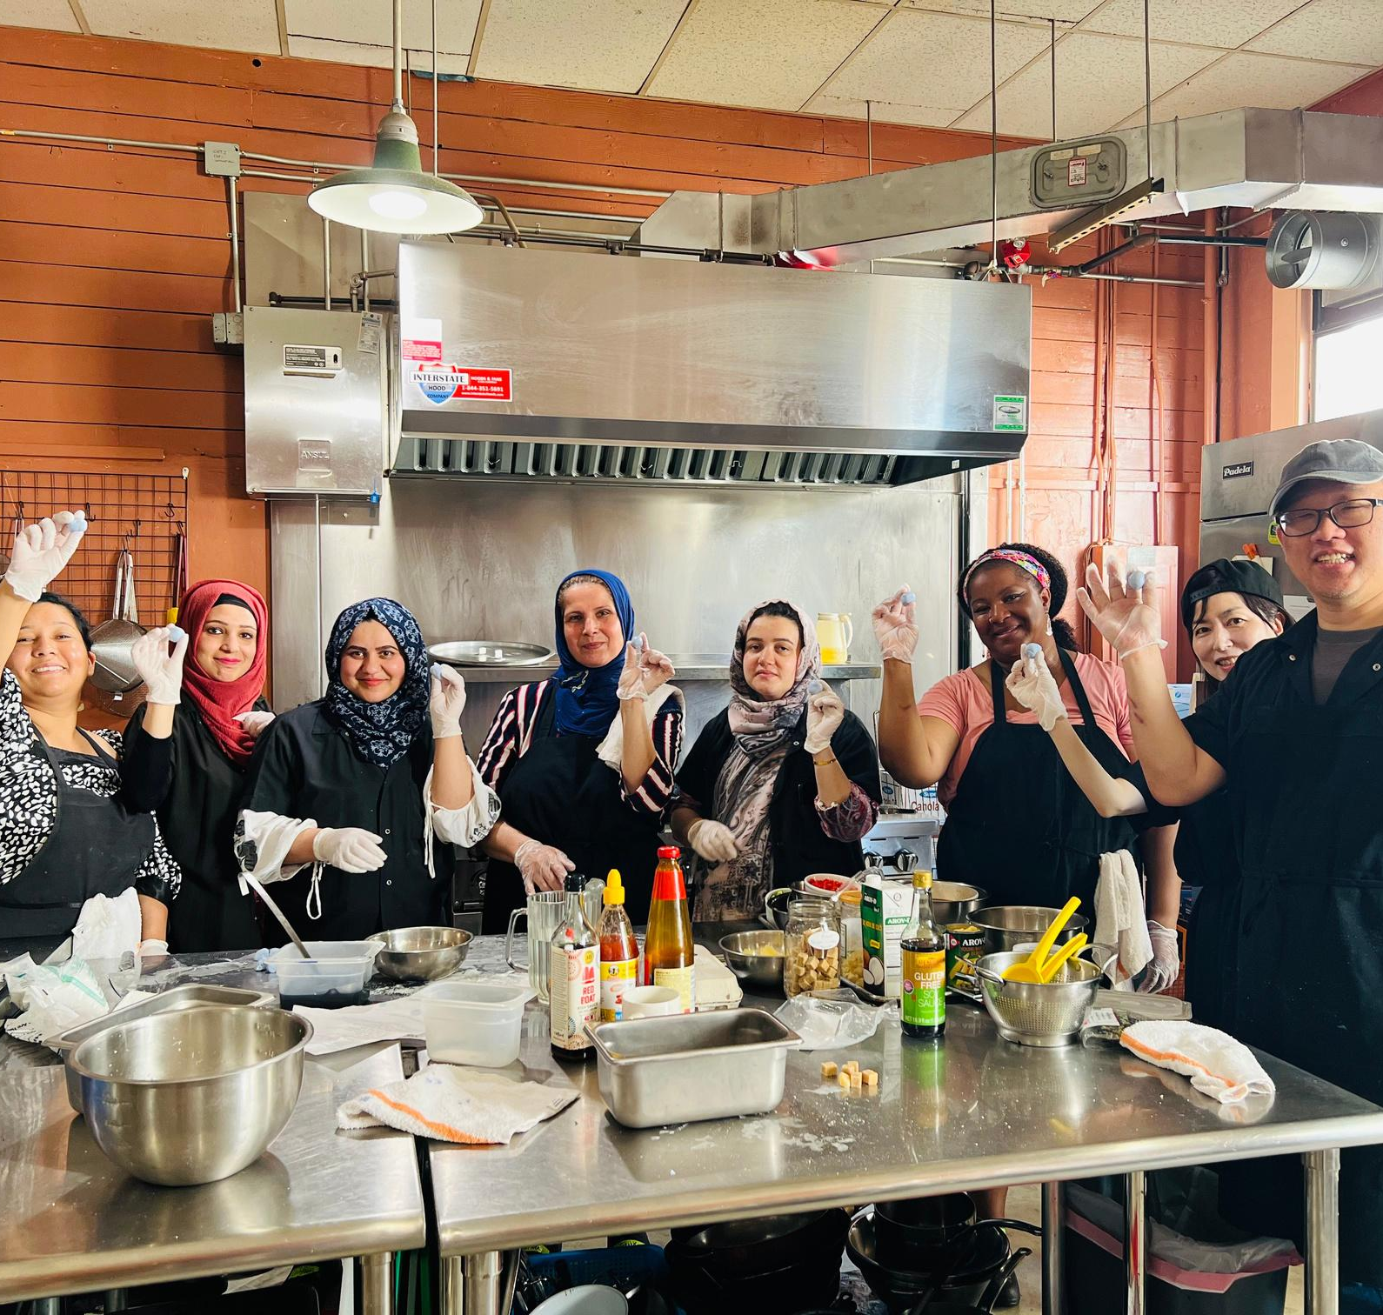




Contact Us:
Telephone
Website
253-236-5297
www.projectfeast.org
Address
Email
202 W Gowe Street
Kent, WA 98032
hello@projectfeast.org
EIN: 46-2005131
Thank You!

